Slide 1
Automated Learning and Data Analysis CSC 422 / 522 Fall 2010
Steffen Heber
Department of Computer Science
Lecture 1: Introduction and Overview
Incorporating slides © by Tan, Steinbach, Kumar, and Jon Doyle

Slide 2
Outline
Syllabus visit web page
Introduction to Data Mining

Slide 3
What Will We Learn?
Topic: discovering knowledge by examining data
Data Mining, Knowledge Discovery, Machine Learning
How does data look like?
How can we handle data?
How to think about it?
``The purpose of computing is insight, not numbers.''
- R. W. Hamming
How can we interpret what we found?
Many examples
Commerce, science, security, medicine, government

Slide 4
Origins of Data Mining
Draws ideas from machine learning/AI, pattern recognition, statistics, and database systems
Traditional Techniques may be unsuitable due to
Enormity of data
High dimensionality of data
Heterogeneous, distributed nature of data
Statistics/ AI
Machine Learning/
Pattern Recognition
Data Mining
Database systems

Slide 5
Course Character
An evolving course
Feedback of all sorts is enormously helpful
Please ask questions!

Slide 6








A Commercial Viewpoint: What is Common Among All of Them?
Data

Slide 7

Why Mine Data? Commercial Viewpoint
Lots of data is being collected and warehoused
Web data, e-commerce
purchases at department/ grocery stores
Bank/Credit Card transactions
Computers have become cheaper and more powerful
Competitive Pressure is Strong
Provide better, customized services for an edge (e.g. in Customer Relationship Management)

Slide 8
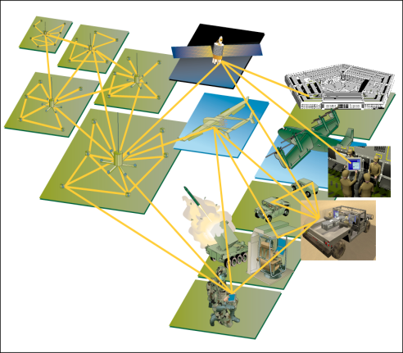
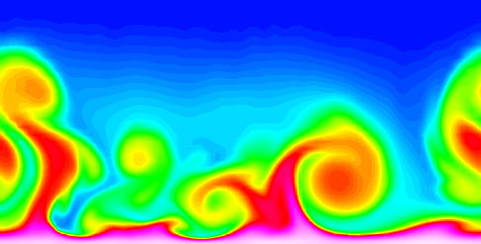
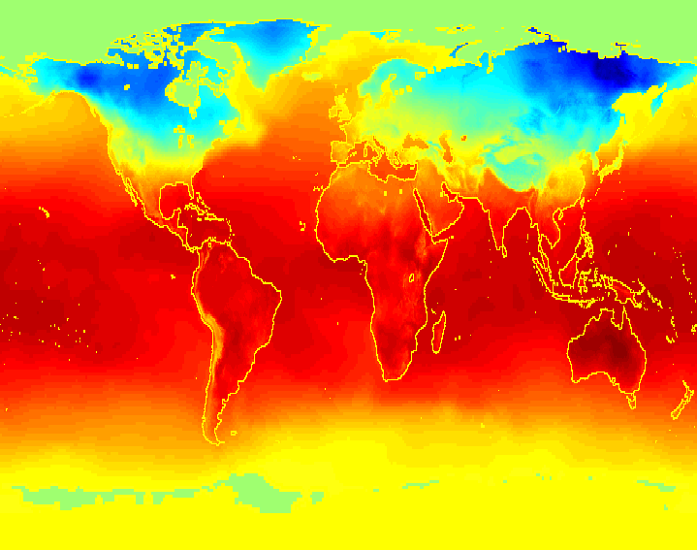
Why Mine Data? Scientific Viewpoint
Data collected and stored at enormous speeds (GB/hour)
remote sensors on a satellite
telescopes scanning the skies
microarrays generating gene expression data
scientific simulations generating terabytes of data
Traditional techniques infeasible for raw data
Data mining may help scientists
in classifying and segmenting data
in Hypothesis Formation

Slide 9
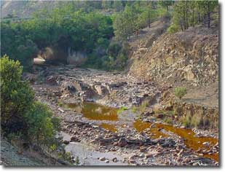
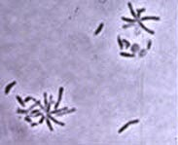
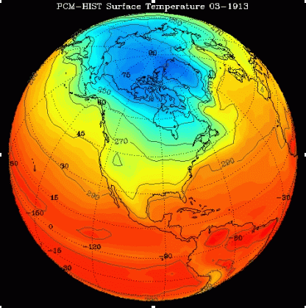
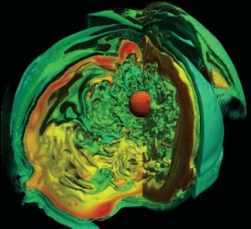
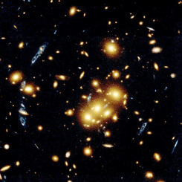

How much data?
1PB/year
20-40TB/simulation
30TB/day
850TB
Ecology
Biology
Climate
Astrophysics
Cosmology
Web
My laptop:
320 GB (GigaBytes) – 10⁹ Bytes
1 TB (TeraByte) – 10¹² Bytes
1 PB (PetaByte) – 10¹⁵ Bytes

Slide 10
Mining Large Data Sets - Motivation
There is often information “hidden” in the data that is not readily evident
Human analysts may take weeks to discover useful information
Much of the data is never analyzed at all
The Data Gap
Total new disk (TB) since 1995
Number of analysts
From: R. Grossman, C. Kamath, V. Kumar, “Data Mining for Scientific and Engineering Applications”

Slide 11
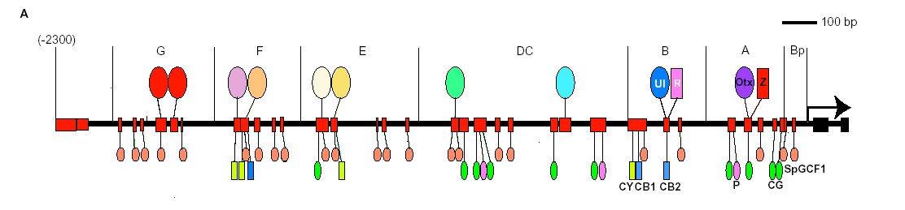
Data Describes Complex Patterns/Phenomena
How to untangle the riddles of the complexity?
Complex regulation
Single gene
~30k genes
50 trans elements control single gene expression
Challenge:
How can we see the forest and not only trees?
Notes:
To determine whether any simple rules exist which may be used to describe the low dimensional behavior of complex systems.
Special issue on complex systems: Science Vol. 284. No. 5411 (1999)

Slide 12
This is Only the Tip of the Iceberg
Challenges of Data Mining:
Scalability
Dimensionality
Complex and Heterogeneous Data
Data Quality
Streaming Data
Data Ownership and Distribution
Privacy Preservation

Slide 13
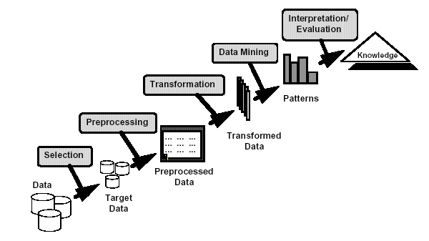
What is Data Mining?
Knowledge Discovery and Data Mining
Non-trivial extraction of implicit, previously unknown and potentially useful information from data
Exploration & analysis, by automatic or semi-automatic means, of large quantities of data in order to discover meaningful patterns
Computing structural descriptions from examples
Notes:
Sequential process is really iterative

Slide 14
What is (not) Data Mining?
What is not Data Mining?
Look up phone number in phone directory
Query an expertsystem
What is Data Mining?
Certain names are more prevalent in certain US locations (O’Brien, O’Rurke, O’Reilly… in Boston area)
Group together similar documents returned by search engine according to their context (e.g. Amazon rainforest, Amazon.com,)

Slide 15
Bonferroni’s Principle
A big data‐mining risk is that you will “discover” patterns that are NOT meaningful.
Bonferroni’s principle: (roughly) if you look in more places for interesting patterns than your amount of data will support, you are bound to find bogus pattern.
or, who searches a lot finds a lot.

Slide 16
Rhine Paradox
The parapsychologist Joseph Rhine hypothesized in the 1950’s that some people had Extra‐Sensory Perception (ESP)
He devised an experiment where subjects were asked to guess 10 hidden cards – red or blue
He discovered that almost 1 in 1000 had ESP –
they were able to get all 10 right Surprised???

Slide 17
Rhine Paradox (con’t)
He told these people they had ESP and called them in for another test of the same type
He discovered that almost all of them had lost their ESP
What did he conclude???

Slide 18
Rhine Paradox (con’t)
He concluded that you shouldn’t tell people they have ESP; it causes them to lose it.
☺

Slide 19
Data Mining Task Classification
categorical
categorical
continuous
class
Test
Set
Learn
Classifier
Training
Set
Model

Slide 20
Classification: Definition
Given a collection of records (training set )
Each record contains a set of attributes, one of the attributes is the class.
Find a model for class attribute as a function of the values of other attributes.
Goal: previously unseen records should be assigned a class as accurately as possible.
A test set is used to determine the accuracy of the model.

Slide 21
Classification: Application 1
Fraud Detection
Goal: Predict fraudulent cases in credit card transactions.
Approach:
Use credit card transactions and the information on its account-holder as attributes.
When does a customer buy, what does he buy, how often he pays on time, etc
Label past transactions as fraud or fair transactions. This forms the class attribute.
Learn a model for the class of the transactions.
Use this model to detect fraud in credit card transactions on an account.

Slide 22
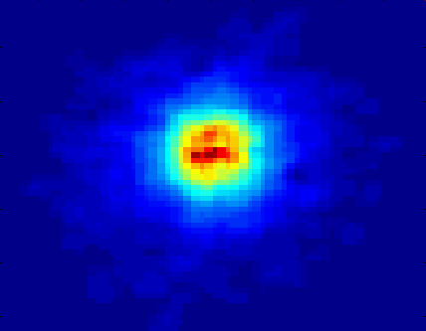
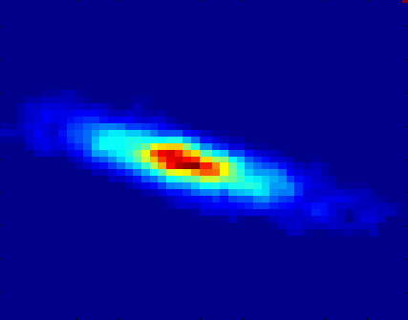
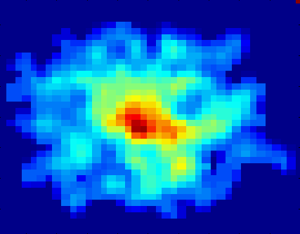
Classifying Galaxies
Courtesy: http://aps.umn.edu
Early
Class:
Stages of Formation
Attributes:
Image features,
Characteristics of light waves received, etc.
Intermediate
Late
Data Size:
72 million stars, 20 million galaxies
Object Catalog: 9 GB
Image Database: 150 GB

Slide 23
Classification: Application 2
Sky Survey Cataloging
Goal: Predict class (star or galaxy) of sky objects based on the telescopic images.
3000 images with 23,040 x 23,040 pixels per image.
Approach:
Segment the image.
Measure image attributes (features) - 40 of them per object.
Model the class based on these features.
Success Story: Could find 16 new high red-shift quasars, some of the farthest objects that are difficult to find!
From [Fayyad, et.al.] Advances in Knowledge Discovery and Data Mining, 1996

Slide 24
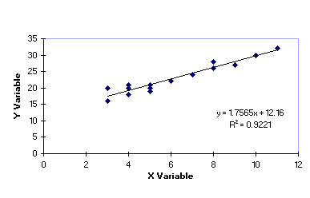
Data Mining Task Regression
Predict continuous valued target variable based on the values of other explanatory variables, assuming a linear or nonlinear dependency.
explanatory variable x | target variable y
4 | 19
6 | 21.5
10 | 29.7
7 | ?

Slide 25
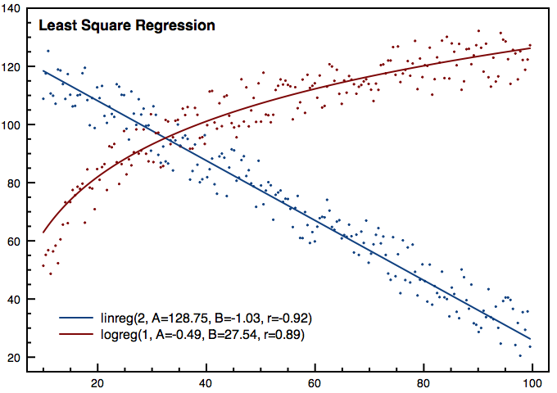
Data Mining Task Regression
Greatly studied in statistics.
Examples:
Predicting sales amounts of new product based on advertising expenditure.
Predicting wind velocities as a function of temperature, humidity, air pressure, etc.
Time series prediction of stock market indices.
Prediction is very difficult, especially about the future. (Niels Bohr, Danish physicist)

Slide 26
Data Mining Task Clustering
Euclidean Distance Based Clustering in 3-D space.
Intracluster distances
are minimized
Intercluster distances
are maximized

Slide 27
Clustering Definition
Given a set of data points, each having a set of attributes, and a similarity measure among them, find clusters such that
Data points in one cluster are more similar to one another.
Data points in separate clusters are less similar to one another.
Similarity Measures:
Euclidean Distance if attributes are continuous.
Other Problem-specific Measures.

Slide 28
Clustering: Application 1
Market Segmentation:
Goal: subdivide a market into distinct subsets of customers where any subset may conceivably be selected as a market target to be reached with a distinct marketing mix.
Approach:
Collect different attributes of customers based on their geographical and lifestyle related information.
Find clusters of similar customers.
Observe buying patterns of customers in same cluster vs. those from different clusters, target clusters individually.

Slide 29
Clustering of S&P 500 Stock Data
Observe Stock Movements every day.
Clustering points: Stock-{UP/DOWN}
Similarity Measure: Two points are more similar if the events described by them frequently happen together on the same day.
We used association rules to quantify a similarity measure.

Slide 30
Data Mining Task Association Rule Discovery
Given a set of records each of which contain some number of items from a given collection;
Produce dependency rules which will predict occurrence of an item based on occurrences of other items.
Rules Discovered:
{Milk} --> {Coke}
{Diaper, Milk} --> {Beer}

Slide 31
Association Rule Discovery: Application 2
Supermarket shelf management.
Goal: To identify items that are bought together by sufficiently many customers.
Approach: Process the point-of-sale data collected with barcode scanners to find dependencies among items.
A classic rule --
If a customer buys diaper and milk, then he is very likely to buy beer.
So, don’t be surprised if you find six-packs stacked next to diapers!

Slide 32
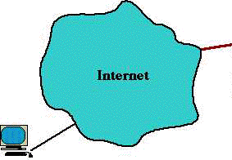
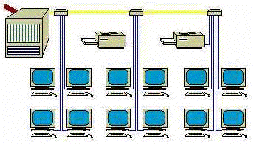
Data Mining Task Anomaly Detection
Detect significant deviations from normal behavior
Applications:
Credit Card Fraud Detection
Network Intrusion Detection
Typical network traffic at University level may reach over 100 million connections per day

Slide 33
Grouping Data Mining Tasks
Prediction Methods
Use some variables to predict unknown or future values of other variables.
Description Methods
Find human-interpretable patterns that describe the data.
From [Fayyad, et.al.] Advances in Knowledge Discovery and Data Mining, 1996

Slide 34
Data Mining Tasks...
Classification ?
Regression ?
Clustering ?
Association Rule Discovery ?
Anomaly Detection ?

Slide 35
Data Mining Tasks...
Classification [Predictive]
Regression [Predictive]
Clustering [Descriptive]
Association Rule Discovery [Descriptive]
Anomaly Detection [Predictive]

Slide 36
Data Mining, Nothing to Worry About?
Collecting data just because it can be collected
Correlating disparate data sources
Bringing civil defense data from FBI, CIA, ICE, CDC, and police into one place
Bringing together medical records from all sources

Slide 37
Data Mining, Nothing to Worry About?
Tyrants
Hitler: detect Jews, communists, gypsies, homosexuals, spies
Stalin: detect Trotskyites, revanchists, bourgeoisie, nationalists, spies
Criminals
Identity theft
Extortion
Discrimination
Insurance, credit, job

Slide 38
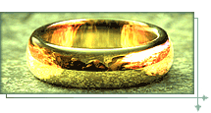
Knowledge is Power (and $$$)
Data collection sites as sources of power
One place to rule them all
One place to find them,
One place to bring them all
And in the darkness bind them

Slide 39
Should We Worry?
Who wants to know?
Who has the right to know?
Who owns data?
The subject?
The collector?
The consumer?
Who decides access to data?
Can one guarantee anonymity?
US census data

Slide 40
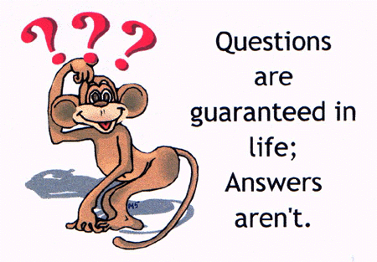
Thank You!

